Slide 1
Cloud Computing
Session 10
Course : COSC6100001 - Cloud Infrastructure
D6825 - Samuel Philip

Slide 2
Learning outcomes
(C4) Analysis : identify problems that can be solved using cloud global infrastructure
(C2) Comprehension : group Classify real-worlds problems in accordance with cloud computing infrastructure
(C4) Analysis : analyze identifying problems and choose proper Cloud Services and Cloud Infrastructure
(C5) Synthesis : design Cloud computing architecture and infrastructure and implementation on applciations

Slide 3
Outline
A Model for Multicore Computing
Communication, Logical Clocks, and Message Delivery Rules
Load Balancing

Slide 4
A Model for Multicore Computing

Slide 5
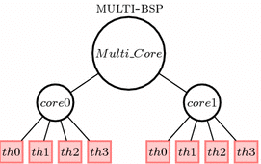
A Model for Multicore Computing
Multi-BSP Model
A hierarchical computing model for multicore systems, represented as a tree of depth d.
The computing substrate of the model includes multiple levels of cache, as well as the size of the memory. A depth-d model is a tree of depth d with caches and memory as the internal nodes of the tree and the processors at the leaves.

Slide 6
A Model for Multicore Computing
Multi-BSP Model
A depth-d model is a tree of depth d with caches and memory as the internal nodes of the tree and the processors at the leaves.
A depth-d model requires 4d parameters. Level i, 1≤i≤d, has four parameters (p_{i},g_{i},L_{i},m_{i}) that quantify the number of subcomponents, the communication bandwidth, the synchronization cost, and the memory/cache size, respectively. The model captures the unavoidable communication cost due to latency Li and bandwidth gi as seen in Fig. 10.7.
Notes:
Multi-BSP model.
A depth-d model is a tree of depth d with caches and memory as the internal nodes of the tree and the processors at the leaves.
pi—the number of (i − 1) level components inside an i-th level component;
gi—the communication bandwidth;
Li—the cost for barrier synchronization for a level-i superstep;
mi—the number of words of memory inside an i-th level component.

Slide 7
A Model for Multicore Computing
Multi-BSP Model
An in-depth description of level i parameters follows:
p_{i}—the number of (i−1) level components inside an i-th level component. The 1st level components consist of p1 raw processors; a computation step on a word in level 1 memory represents one unit of time.
g_{i}—the communication bandwidth, the ratio of the number of operations of a processor to the number of words transmitted between the memories of a component at level i and its parent component at level (i+1), in a unit of time. A word represents the data the processor operates on. Level 1 memories can keep up with the processors; thus their data rate, g0, is one.
L_{i}—the cost for barrier synchronization for a level i superstep. The barrier synchronization is between the subcomponents of a component; there is no synchronization across separated branches in the component hierarchy.
m_{i}—the number of words of memory inside an i-th level component that is not inside any (i−1) level component.
Notes:
Multi-BSP model.
A depth-d model is a tree of depth d with caches and memory as the internal nodes of the tree and the processors at the leaves.
pi—the number of (i − 1) level components inside an i-th level component;
gi—the communication bandwidth;
Li—the cost for barrier synchronization for a level-i superstep;
mi—the number of words of memory inside an i-th level component.

Slide 8
A Model for Multicore Computing
Multi-BSP Model
A parameter-free version of an optimal Multi-BSP algorithm with respect to a given algorithm A means that it is optimal in:
Parallel computation steps to within multiplicative constant factors and in total computation steps to within additive lower order terms.
Parallel communication costs to within constant multiplicative factors among Multi-BSP algorithms.
Synchronization costs to within constant multiplicative factors among Multi-BSP algorithms.
Notes:
Multi-BSP model.
A depth-d model is a tree of depth d with caches and memory as the internal nodes of the tree and the processors at the leaves.
pi—the number of (i − 1) level components inside an i-th level component;
gi—the communication bandwidth;
Li—the cost for barrier synchronization for a level-i superstep;
mi—the number of words of memory inside an i-th level component.

Slide 9
Communication, Logical Clocks, and Message Delivery Rules

Slide 10
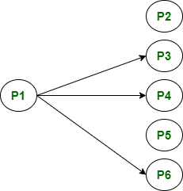
Communication
Communicating processes often run on distant systems whose physical clocks cannot be perfectly synchronized due to communication latency.
Global ordering of events in communicating processes running on such systems is not feasible, and logical clocks are used instead.
Also, messages travel through physical channels with different speeds and follow different paths.
As a result, the order in which messages are delivered to processes may be different than the order they were sent.
That’s why it is necessary to have Logical clocks to provide necessary abstraction

Slide 11
communication
Logical clocks
A logical clock (LC) is an abstraction necessary to ensure the clock condition given by Eqs. (10.24) and (10.25) in the absence of a global clock.
Each process pi maps events to positive integers. Call LC(e) the local variable associated with event e. Each process time stamps each message m sent with the value of the logical clock at the time of sending, TS(m)=LC(send(m)).

Slide 12
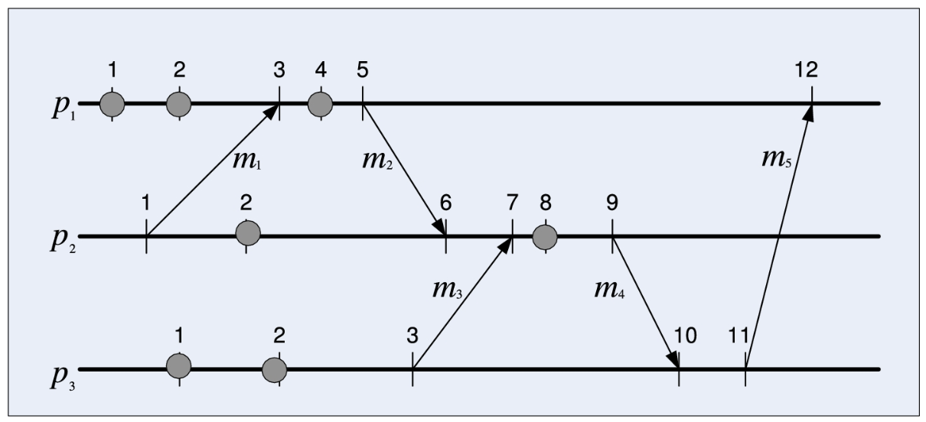
communication
Logical clocks
The concept of logical clocks is illustrated in figure below using a modified space–time diagram
the events are labeled with the logical clock value. Messages exchanged between processes are shown as lines from the sender to the receiver; the communication events corresponding to sending and receiving messages are marked on these diagrams.
Notes:
Three processes and their logical clocks;
The usual labeling of events as $e_{1}^{1},e_{2}^{1}$, $e_{3}^{1}$,... is omitted to avoid overloading the figure;
only the logical clock values for the local and for the communication events are marked.
The correspondence between the events and the logical clock values is obvious: $e_{1}^{1}{,e}_{1}^{2}e_{1}^{3}→1,e_{5}^{1}→5,e_{4}^{2}→7,e_{4}^{3}→10,e_{6}^{1}→12,$ etc.
Global ordering of all events is not possible; there is no way to establish the ordering of events $e_{1}^{1}{,e}_{1}^{2} and e_{1}^{3}$.

Slide 13
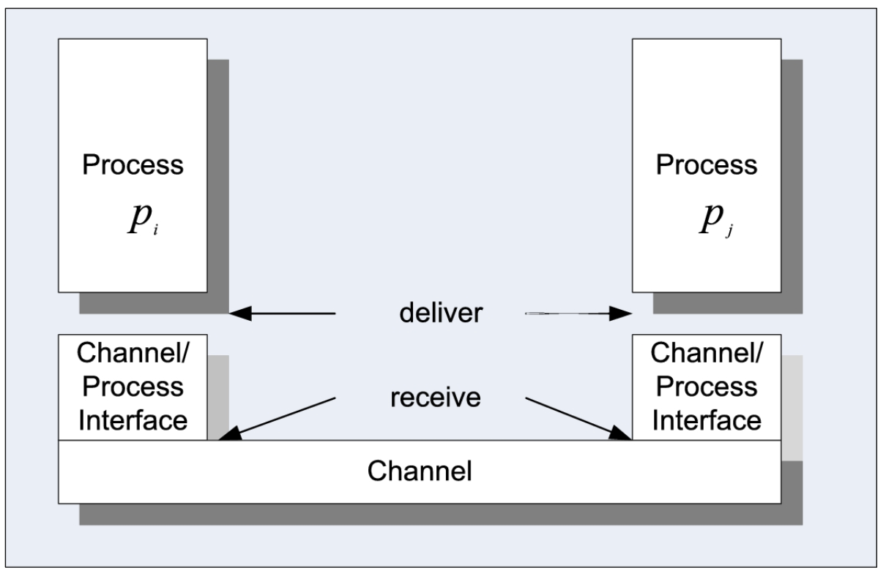
communication
Message delivery
The communication channel abstraction makes no assumptions about the order of messages; a real-life network might reorder messages.
Message receiving and message delivery are distinct operations. Since real-life networks can reorder messages, a delivery rule establishes when a received message is actually delivered to the destination process.
Notes:
Three processes and their logical clocks;
The usual labeling of events as $e_{1}^{1},e_{2}^{1}$, $e_{3}^{1}$,... is omitted to avoid overloading the figure;
only the logical clock values for the local and for the communication events are marked.
The correspondence between the events and the logical clock values is obvious: $e_{1}^{1}{,e}_{1}^{2}e_{1}^{3}→1,e_{5}^{1}→5,e_{4}^{2}→7,e_{4}^{3}→10,e_{6}^{1}→12,$ etc.
Global ordering of all events is not possible; there is no way to establish the ordering of events $e_{1}^{1}{,e}_{1}^{2} and e_{1}^{3}$.

Slide 14
communication
Causal Delivery
Causal delivery is an extension of the FIFO delivery that applies when a process receives messages from multiple sources.
when a process receives messages from different sources. Assume a group of three processes (p_{i},p_{j},p_{k}) and two messages m and m′.
Notes:
Three processes and their logical clocks;
The usual labeling of events as $e_{1}^{1},e_{2}^{1}$, $e_{3}^{1}$,... is omitted to avoid overloading the figure;
only the logical clock values for the local and for the communication events are marked.
The correspondence between the events and the logical clock values is obvious: $e_{1}^{1}{,e}_{1}^{2}e_{1}^{3}→1,e_{5}^{1}→5,e_{4}^{2}→7,e_{4}^{3}→10,e_{6}^{1}→12,$ etc.
Global ordering of all events is not possible; there is no way to establish the ordering of events $e_{1}^{1}{,e}_{1}^{2} and e_{1}^{3}$.

Slide 15
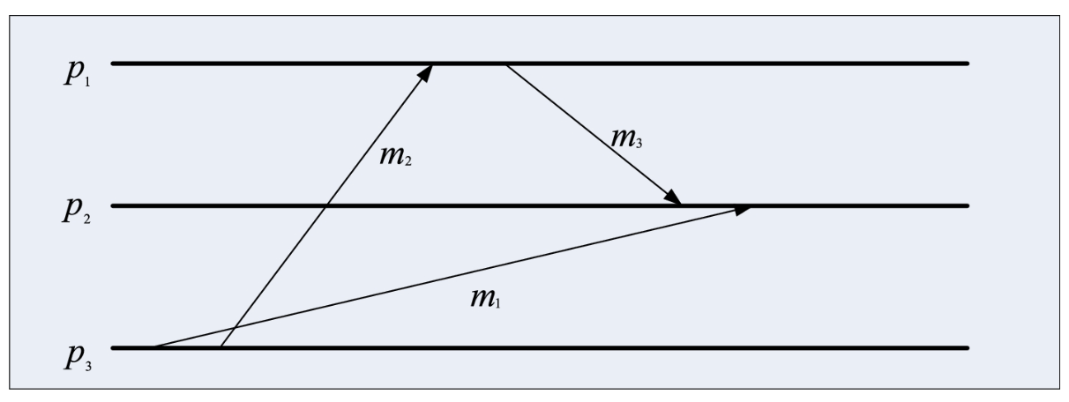
communication
Violation of causal delivery when more than two processes are involved;
message m₁ is delivered to process p₂ after message m₃, though message m₁ was sent before m₃.
Indeed, message m₃ was sent by process p₁ after receiving m₂, which in turn was sent by process p₃ after sending message m₁.

Slide 16
Load Balancing

Slide 17
Load Balancing
A general formulation of the load balancing problem is to evenly distribute N objects to P places.
Another formulation of the load balancing is in the context of placing m balls into n<m bins, chosen independently and uniformly at random.
Load balancing can also be formulated in the context of hashing as the problem of placing m items sequentially in n<m bins; the task is determining the longest time for finding an item.

Slide 18
Load Balancing
The load balancing problem in a distributed system is formulated as follows: given a set T of tasks, distribute them to a set of P processors, which compute at the same rate, such that only one task can run at any given time on one processor; there is no preemption and each task runs to completion.
The importance of load balancing is undeniable, and practical solutions to overcome the algorithmic complexity are widely used. For example, randomization suggests to distribute the tasks to processors chosen independently and uniformly at random.
This random distribution strategy should lead to an almost equal load of processors, provided that there are enough tasks and that the distribution of the task execution times is rather narrow. Several other heuristics are used in practice.

Slide 19
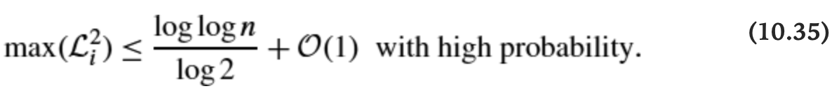
Load balancing
The Balls-and-Bins Model
The load balancing problem is often discussed using the balls-and-bins model.
In this model, we define the load of a bin as the number of balls in the bin.
A better load balance is achieved when the balls are placed sequentially, and for each ball, we choose two bins independently and uniformly at random, then place the ball into the less full bin. In this case, the maximal load, max⁡(Li2),1≤i≤n is
Notes:
Three processes and their logical clocks;
The usual labeling of events as $e_{1}^{1},e_{2}^{1}$, $e_{3}^{1}$,... is omitted to avoid overloading the figure;
only the logical clock values for the local and for the communication events are marked.
The correspondence between the events and the logical clock values is obvious: $e_{1}^{1}{,e}_{1}^{2}e_{1}^{3}→1,e_{5}^{1}→5,e_{4}^{2}→7,e_{4}^{3}→10,e_{6}^{1}→12,$ etc.
Global ordering of all events is not possible; there is no way to establish the ordering of events $e_{1}^{1}{,e}_{1}^{2} and e_{1}^{3}$.

Slide 20
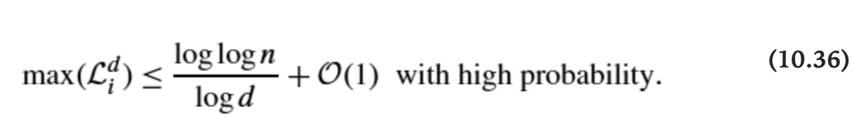
Load balancing
The Balls-and-Bins Model
This result called the power of two choices, shows that having two or more choices leads to an exponential improvement of the load balance. When the number of bins that contain at least j balls conditioned on the number of bins that contain at least (j−1) balls is inductively bound.
If the choice for each ball is extended from 2 to d bins, then the result is further improved.
The GREEDY algorithm considers an (m,n,d) problem:
n initially empty bins, m balls to be placed sequentially in the bins, and d choices made independently and uniformly at random with replacement. Each ball is placed in the least loaded of the d bins, and ties are broken arbitrarily. Then, the maximum load, the maximum number of balls in a bin, has an upper bound of

Slide 21
Load balancing
Parallelization of The Randomized Load Balance
The strategies analyzed are symmetric, all balls and bins use the same algorithm, and all possible destinations are chosen independently and uniformly at random.
An algorithm is asynchronous if an entity, a ball or a bin, does not have to wait for a round to complete; it only has to wait for messages addressed to it, rather than waiting for messages addressed to another entity.
A round is synchronous if a barrier synchronization is required between some pairs of rounds.

Slide 22
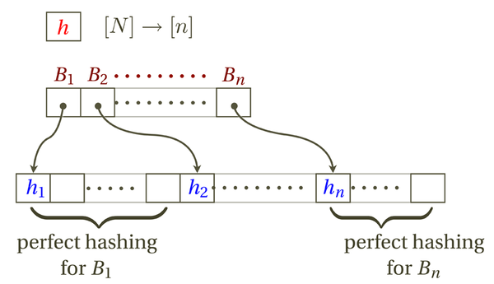
Load balancing
The Balls-and-Bins Model - hashing
The balls-and-bins model has applications to hashing
Using two hash functions to map keys and placing the item in the shorter chain (based on the power of two choices) substantially reduces the maximum search time to O(log log n) with high probability.

Slide 23
Exercise
Discuss and find the best types of load balancing algorithms, provide your reason!

Slide 24
References
Marinescu, Dan C. (2022). Cloud Computing Theory and Practice: 3rd Edition. Morgan Kaufmann Publishers. ISBN: 978-0-323-85277-7

Slide 25
Thankyou

